Slide 1
DAY2
Lets Play with React

Slide 2
Virtual DOM
The Virtual DOM is an abstraction of the HTML DOM. It is lightweight and
detached from the browser-specific implementation details.
Good to Read https://www.accelebrate.com/blog/the-real-benefits-of-the-virtual-dom-in-react-js/

Slide 3
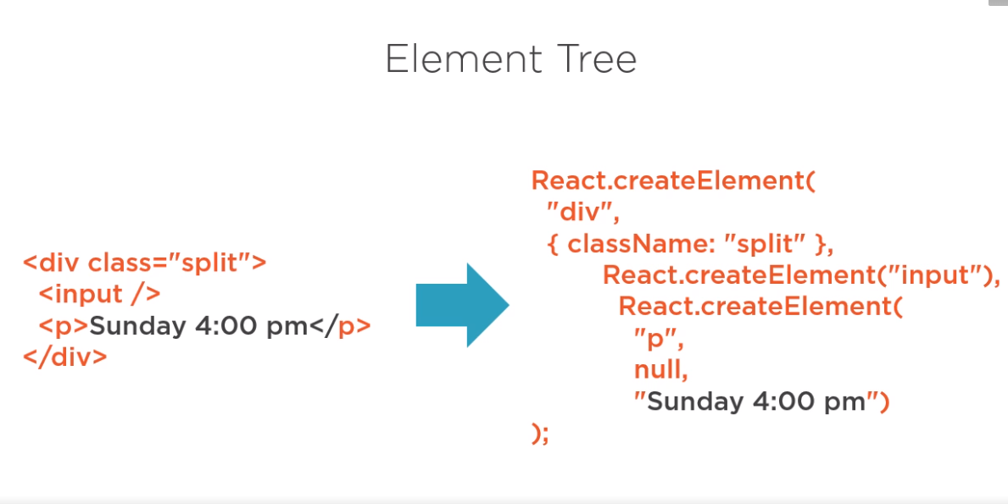

Slide 4
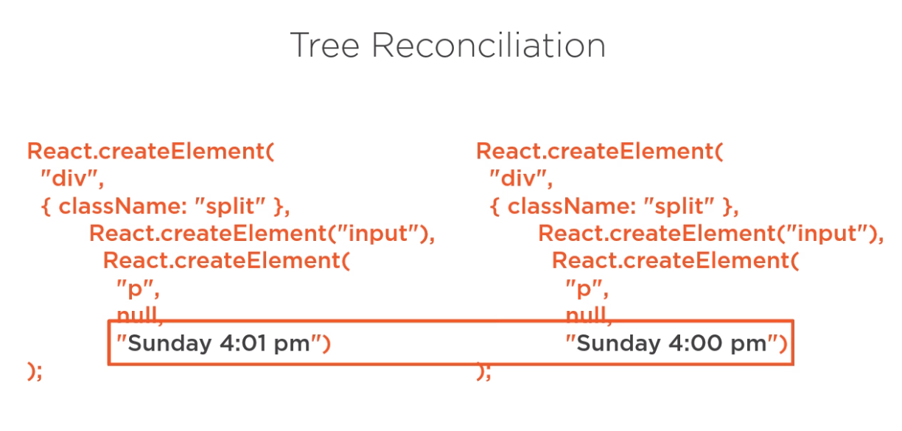

Slide 5
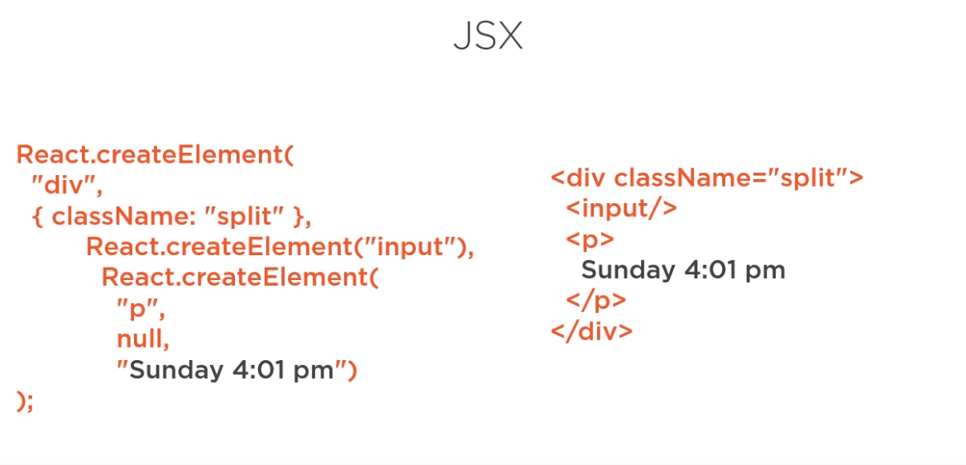
We need babel here to make our life easy with syntax

Slide 6
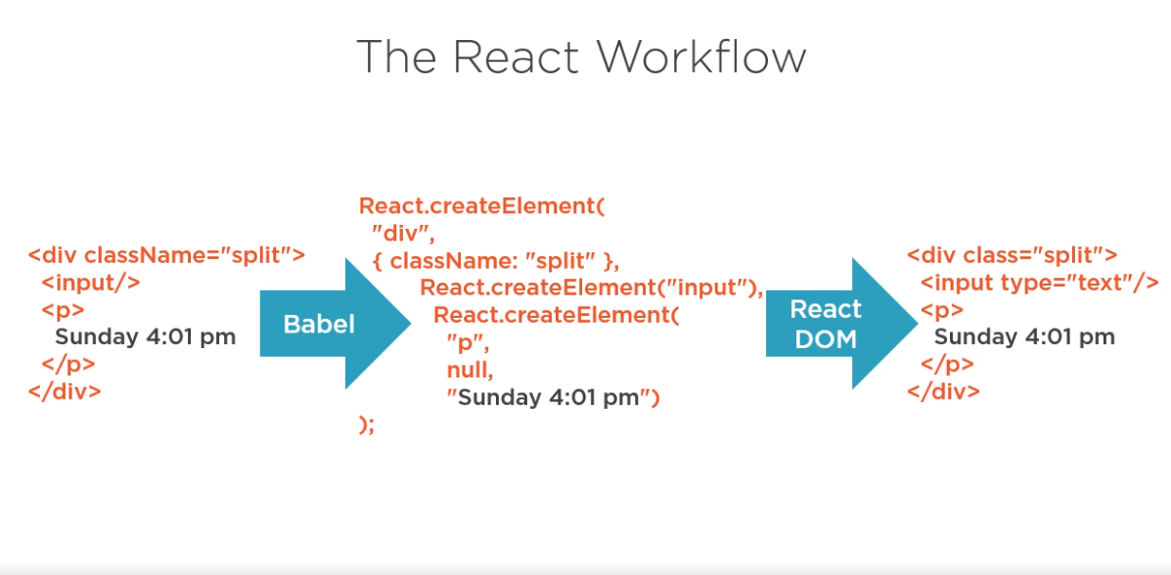

Slide 7
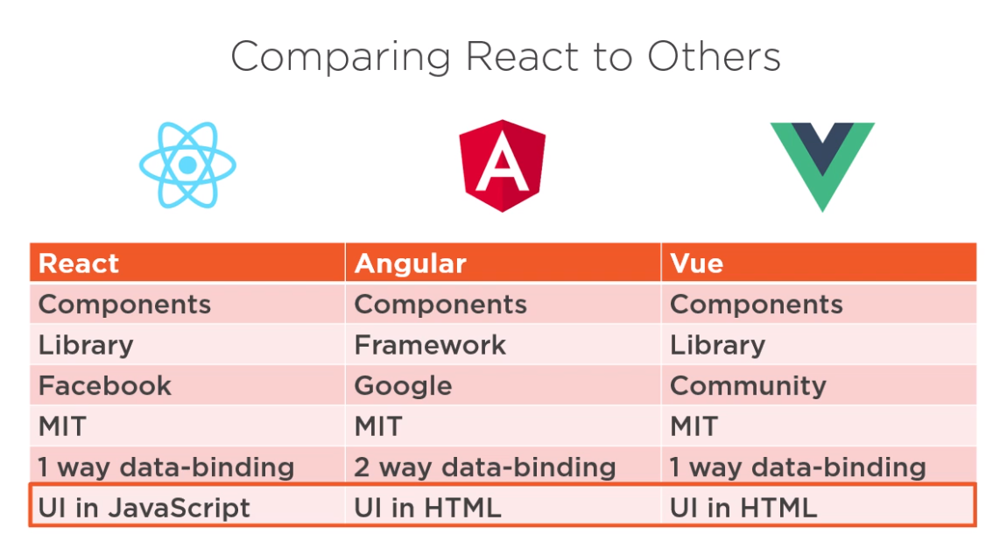
Other popular FrameWorks used industry

Slide 8
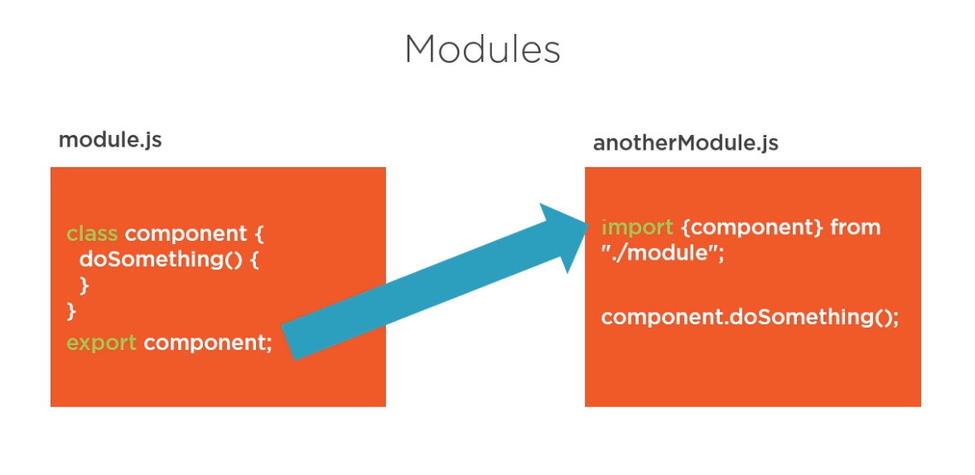

Slide 9
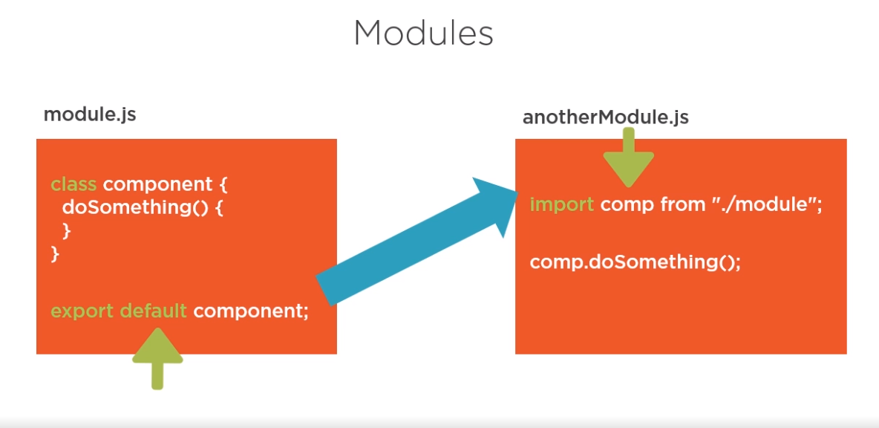

Slide 10
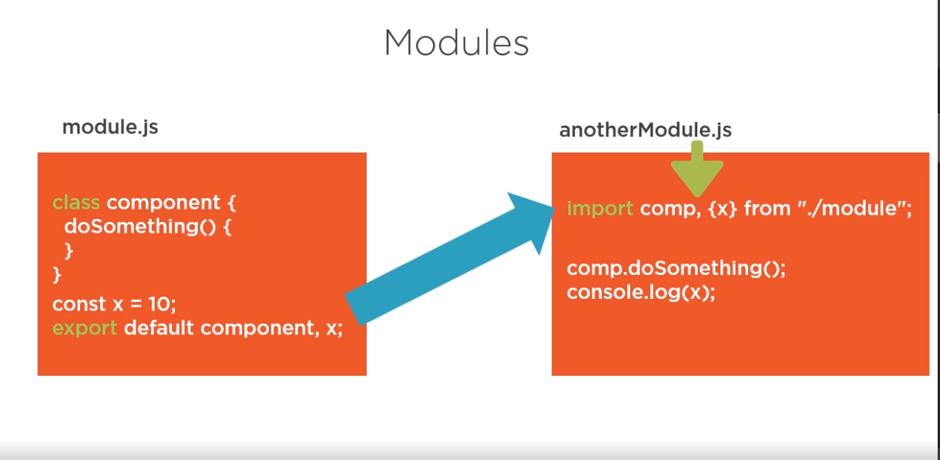

Slide 11
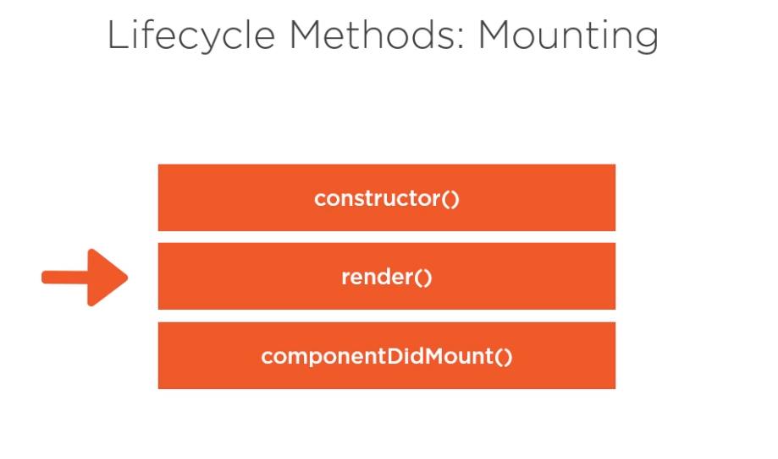

Slide 12
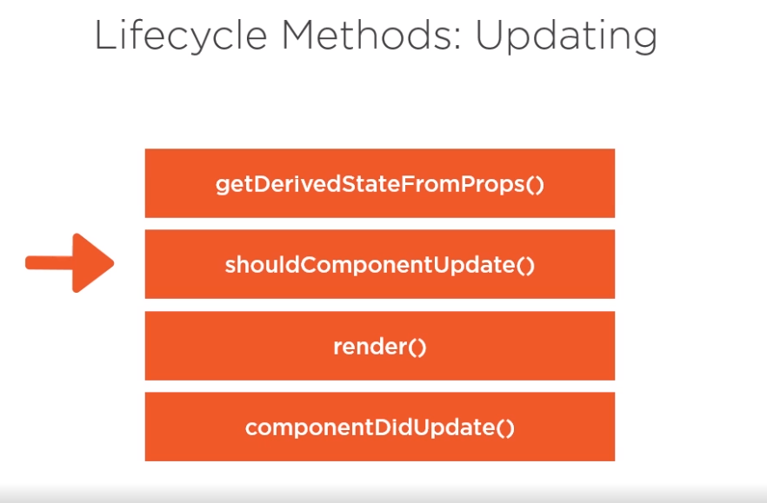

Slide 13
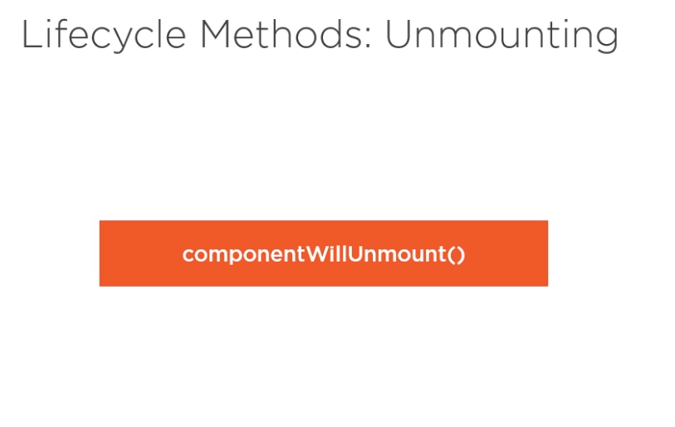

Slide 14
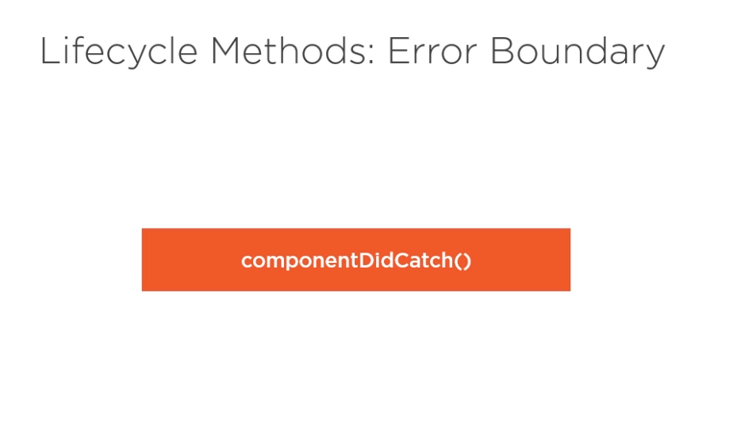

Slide 15
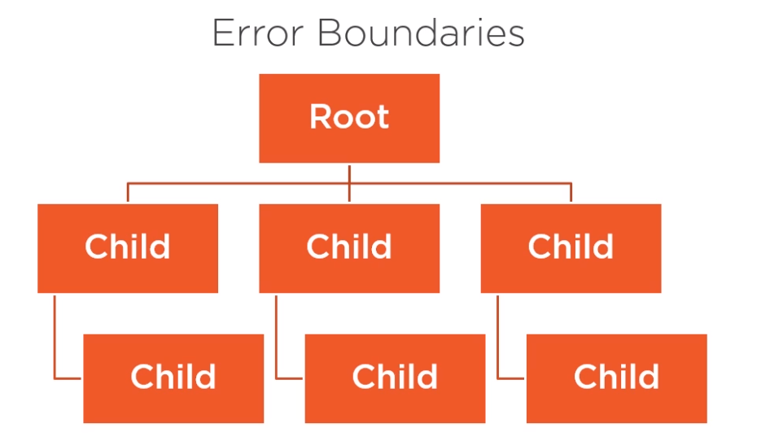
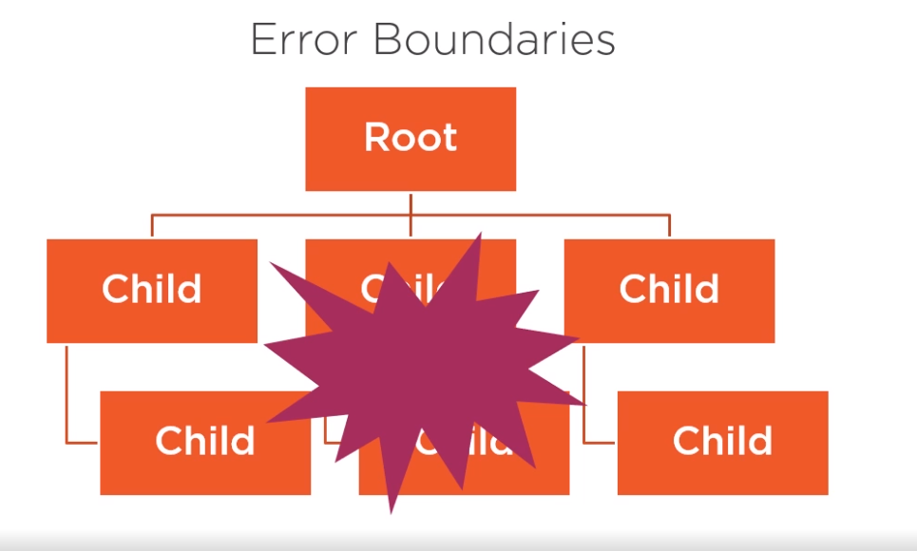
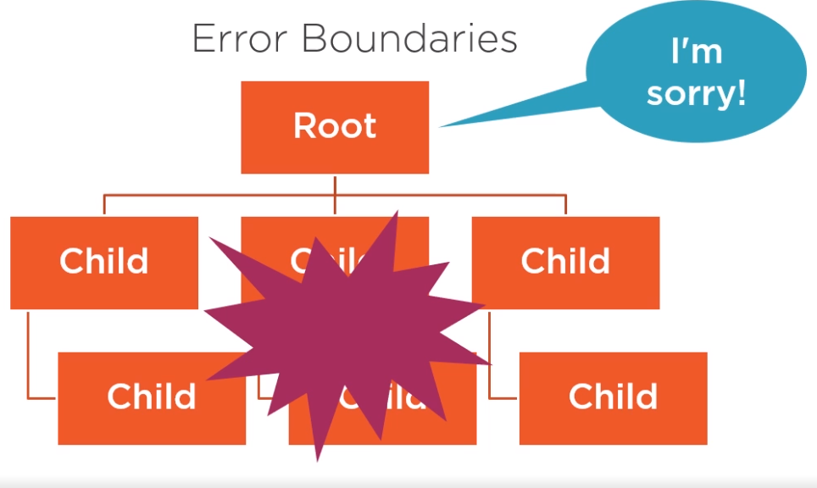

Slide 16
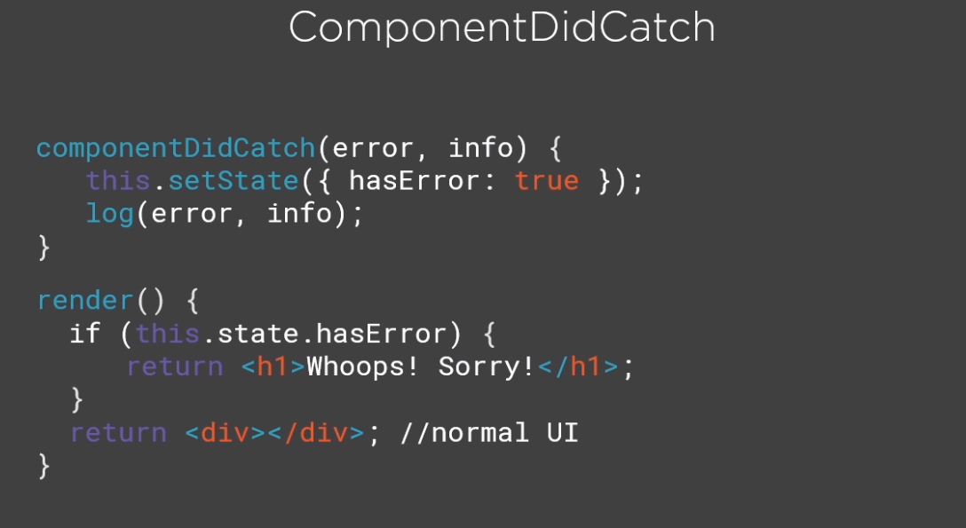

Slide 17
